Slide 1
INVESTMENT ASSIGNMENT SUBMISSION
Name: Jitendra Kumar Kushwaha

Slide 2
Identifying the best sectors, countries for making investments
Goals
Find out the details of the amount invested in the venture, seed, angel and private equity and the best sector to invest amount.
Find out the most invested countries and best choice of the investors.
More accurate results of the investment amounts in the venture, seed, angel and private equity.
Data Cleaning
Graphical Representations

Slide 3
Problem solving methodology
data of companies
Funding data
Mapping sectors data
Input Data
Identification required details
Identification of common keys
Data Understaning & Cleaning
Merge Data
Sector mapping with category list
Handling Missing Data
Outliers Identification
Merge Data
Extract Required Details
END

Slide 4
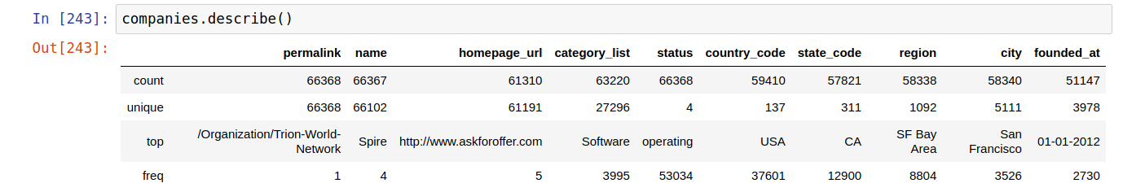
Business and Data Understanding
Invest only in English-speaking countries and invest between 5 to 15 million USD per round of investment.
Load the companies and rounds data in the dataframe using “ISO-8859-1” encoded format.
Explored and understand data using pandas methods like .info(), .describe(), .head(), .tail(),.shape etc.
Identifying the common keys column.

Slide 5
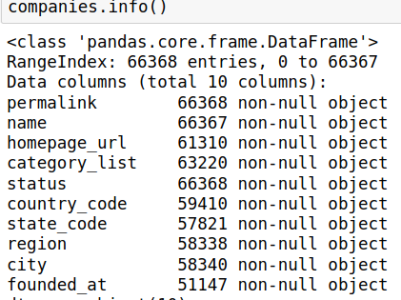
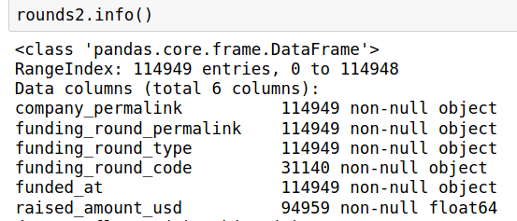
Data Cleaning
Companies Datasets
Identifying the keys column
Change the key in the lowercase and decode in 'ISO-8859-1' format and decode ASCII characters.
Merge companies datasets to the rounds datasets.
Rounds Datasets
Identifying the keys column
Change the key in the lowercase and decode in 'ISO-8859-1' format and decode ASCII characters.
rounds2['company_permalink'].isin(companies['permalink'])

Slide 6
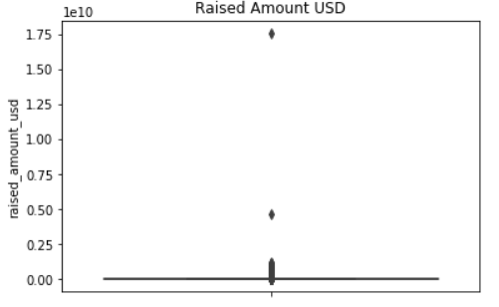
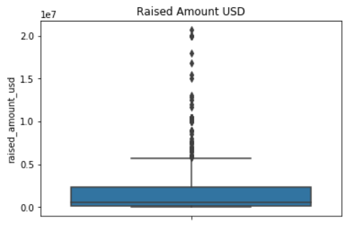
Data Cleaning Cont.
Merged two datasets
master_frame = pd.merge(rounds2, companies, on='permalink')
Funding type analysis in the master_frame
Removed the column which are not useful for the analysis
Handled missing data for the selected investments type ['venture', 'angel', 'seed', 'private_equity']
Detect outliers with z-score based on the investments type and after performed data aggregation and updated NaN value with mean, median or mod.
Below boxplot chart for the angel investmetn type.

Slide 7
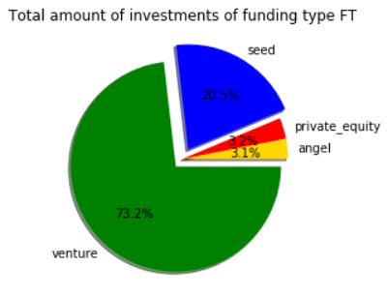
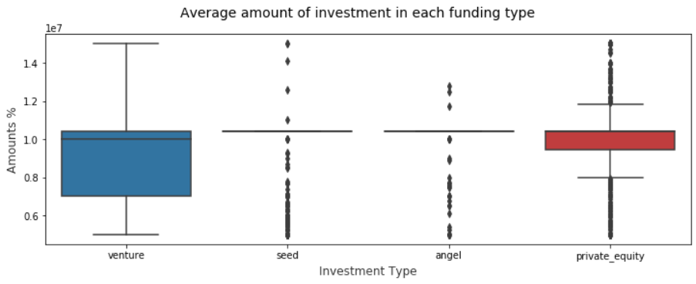
Total investments (globally) in angel, venture, seed, and private equity

Slide 8
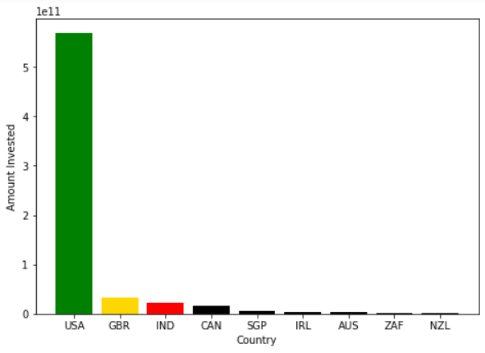
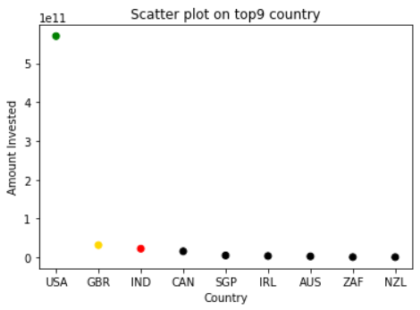
Top 9 countries against the total amount of investments of funding type FT

Slide 9
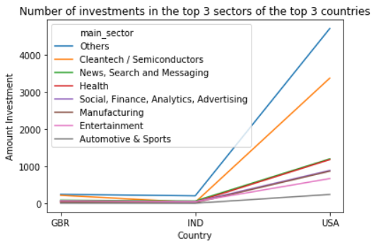
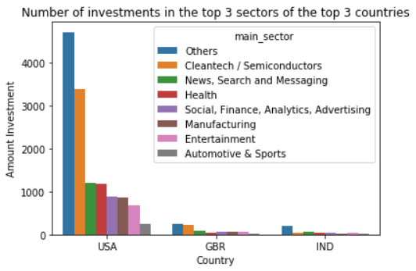
Number of investments in the top 3 sectors of the top 3 countries

Slide 10
Conclusions
As per the analysis.
USA, GBR & IND are the top three countries where investors are investing.
USA is a top country where investors are investing and which has highest investment comparison to any other countries.
Venture type investment is in the top from the choosen investment type.
Others & Cleantech / Semicondutors are the top 2 sectors where investors are investing.

